Slide 1


TestifAI: A Comprehensive Testing Framework for Safe AI Arooj Arif ¹, Alexandros Koliousis¹, Elena Botoeva² ¹Northeastern University, ²Kent University
Notes:
Hello everyone,
Today, I’m here to talk about my PHD research that is relevant to testing of AI .
Understanding Testing vs. Verification of AI in Autonomous Cars
Testing:
What it is: Testing is about checking how well the autonomous car works by using it in different situations.
Example:
Imagine you have a self-driving car.
To test it, you drive the car through different neighborhoods and situations:
During the day and at night.
In sunny, rainy, and foggy weather.
On busy streets and quiet roads.
You observe if the car stops at all stop signs, regardless of the different conditions it encounters.
Purpose: To see if the car performs well under various real-life situations.
Verification:
What it is: Verification is about ensuring that the autonomous car will always recognize and stop at a stop sign, no matter the conditions.
Example:
You take the same self-driving car and verify it by creating specific, controlled conditions:
You place a bird on the stop sign.
You test the stop sign at night with low lighting.
You partially cover the stop sign with a tree branch.
You ensure that in all these controlled scenarios, the car consistently recognizes the stop sign and stops every time.
Purpose: To ensure the car meets certain standards and works reliably under all expected conditions.
Key Difference Using the Same Example:
Testing: Is like driving the car around in different real-world situations to see if it stops at stop signs. It’s about observing performance in various conditions.
Verification: Is like setting up specific, controlled scenarios to check if the car always recognizes and stops at stop signs. It’s about ensuring reliability under specific conditions.
How to Explain in Your Talk:
“Imagine you have a self-driving car. To test it, you drive it through different neighborhoods, during different times of the day, and in various weather conditions to see if it stops at stop signs. This shows how well the car performs in real-life situations. On the other hand, verification involves creating specific conditions, like placing a bird on the stop sign or testing it at night, to ensure the car always recognizes and stops at the stop sign. This ensures the car meets certain standards and works reliably. In our work, I focus on testing AI to see how well it performs in various situations, while Zahra works on verifying AI to ensure it meets specific standards and is reliable.”
1

Slide 2
About me!
Education:
Bachelor’s in Software Engineering (Gold Medalist)
Master’s in Software Engineering
Thesis in AI (4 Journals, 7 Conference Papers)
Professional Experience:
Android Developer, SOFIT Consultancy (Pvt) Ltd
Research Assistant, ComSens Lab, Pakistan
Lecturer, AIR University, Pakistan
NCEAC Focal person (Handle Accreditation
Visits (Software Engineering, AI, Gaming))
Current: PhD in Computer Science
Research Focus: Testing AI Systems
Notes:
My name is Arooj. If I tell you little bit about me. I have a background in software engineering, having completed my Bachelor's degree with a gold medal. and then I have done my Master's degree, where my master thesis focused on Artificial Intelligence (AI). During my Master's, I published 2 journal articles and 2 articles are in queue and presented 7 conference papers. during my masters i worked as research assistant in COMSens lab like 2 years
After completing my Master's, I worked as a lecturer at AIR University in Pakistan like 2.5 years. Now, I am pursuing my PhD, working on a project that combines software engineering and AI. My current research focuses on how we can ensure AI systems performance in real-world situations.
Testing: It’s about observing performance in real-world conditions.
Verification: Is about ensuring reliability under specific conditions

Slide 3
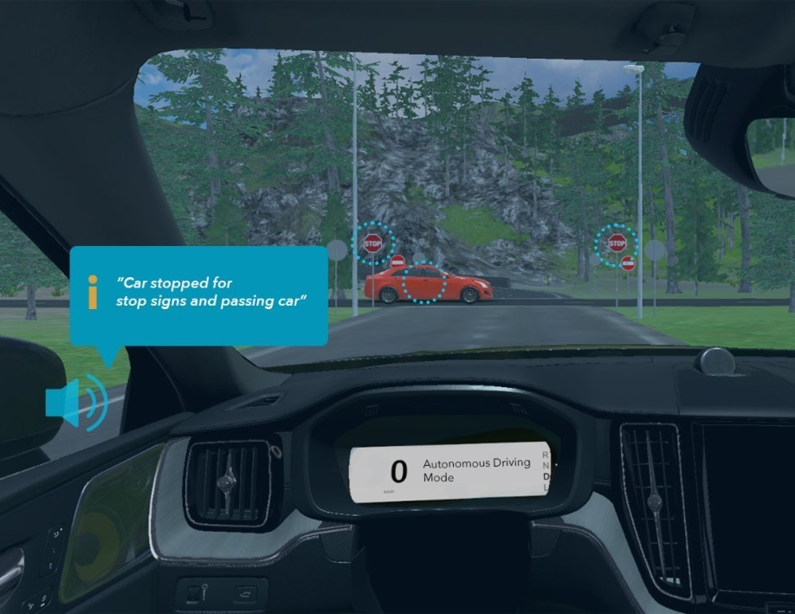
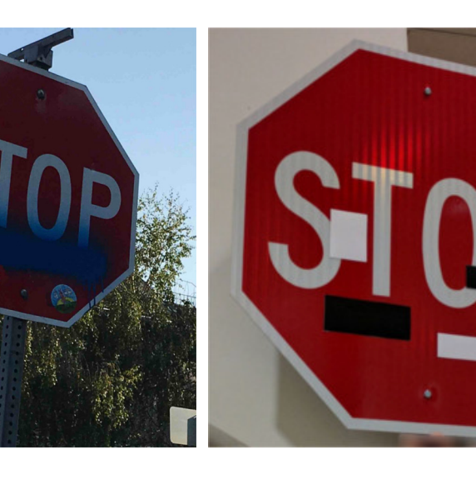

Imagine an Autonomous Car
Scenario: Autonomous car approaching a stop sign
Problem: Bird partially covers the stop sign
Result: Car fails to stop, causing an accident
Notes:
Imagine you are sitting inside an autonomous car, just like in this image. The car is driving itself, approaching a stop sign. However, there's a small bird sitting on the stop sign, partially covering it.
In this scenario, the car , which is responsible for recognizing stop signs, fails to correctly identify the stop sign because of the bird. As a result, the car doesn't stop at the stop sign, leading to a potential accident.
This example shows how it is important to test these AI systems thoroughly.

Slide 4
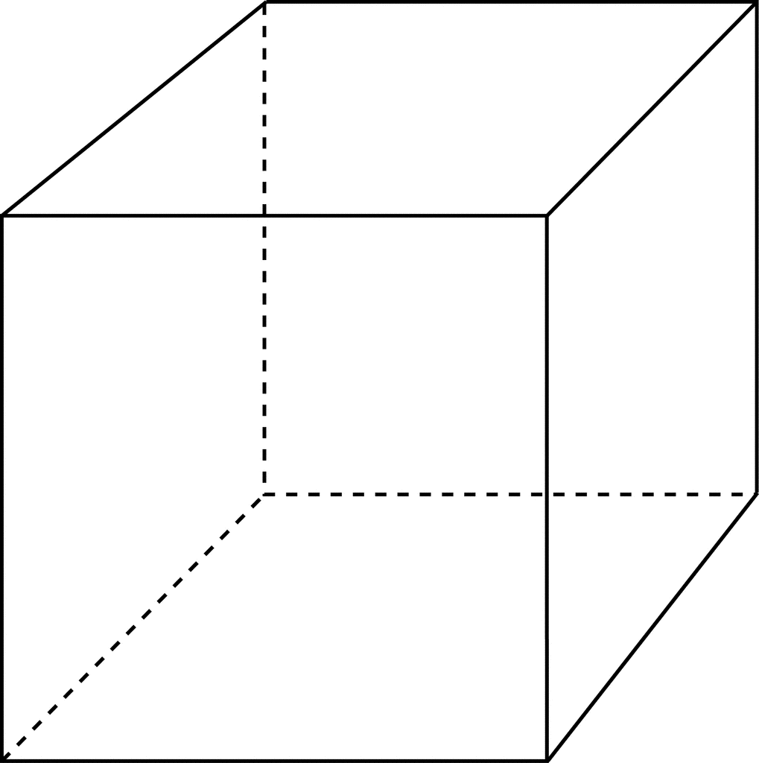


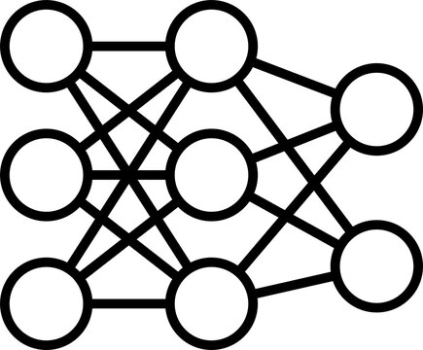


Enhancing Safety in AI: The Urgency of Thorough Testing
AI is used in safety critical systems (healthcare, automotive, avionics).
Neural Networks are sensitive to perturbations.
Perturbed Value
$$ε$$
DOG
Original Pixel
CAT
NN
NNs, just like standard programs, need to be tested for correctness.
Core Challenge: How to test an AI System thoroughly?
Notes:
here you can see if we change few pixel s of CAT, NN predict it as DOG. now one might think that why we are using this model if they confuse by these little change.. well according to some research, in a second 7 megabyte data are generated per person on earth, that is collectively in quantillium per person per day, so one possible solution is deep models to handle this large amount of data . and these models are used in safety critical systems
Just like regular software needs thorough testing, deep learning models need even more careful testing. This is especially important for AI used in critical areas like healthcare, self-driving cars, and aviation. bcz humans life are on stake in these systems
so over the past decade we've seen some tremendous growth in artificial intelligence across safety critical domains .
in the field of autonomy and Robotics we now have models that can make critical decisions about things like self-driving at a second's notice and these are Paving the way for fully autonomous vehicles and robots and that's not where this stops in the field of medicine and Healthcare robots are now equipped to conduct life-saving surgery we have algorithms that generate predictions for critical drugs that may cure diseases that we previously thought were incurable and we have models that can automatically diagnose diseases without intervention from any Health Care Professionals at all these advances are revolutionary and they have the potential to change Life as we know it today but there's another question that weneed to ask which is where are these models in real life a lot of these Technologies were innovated five ten
years ago but you and I don't see them in our daily lives so what is what's the Gap here between Innovation and deployment the reason why you and I can't go buy self-driving cars or robots don’t typically assist in operating rooms is this these are some headlines about the failures of AI from the last few years alone in addition to these incredible Advantage advances we've also seen catastrophic failures and every single one of the safety critical domains I just mentioned
these problems range from crashing autonomous vehicles to healthcare algorithms that don't actually work for everyone even though they're deployed
out in the real world so everyone can use them now at a first glance this seems really demoralizing if these are all of the
things wrong with artificial
intelligence how are we ever going to
achieve that vision of having our AI
integrated into the fabric of our daily
lives in terms of safety critical
deployment
but at them is this is exactly the type
of problem that we solve we want to
bring these advances to the real world
and the way we do this is by innovating
in the Spheres of safe and trustworthy
artificial intelligence in order to
bring the things that were developed in
research labs around the world to
customers like you and me
and we do this by our core ideology is
that we believe that all of the problems
on this slide are underlaid by two key
Notions the first is bias
bias is what happens when machine
learning models do better on some
demographics than others this results

Slide 5
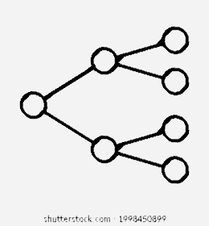

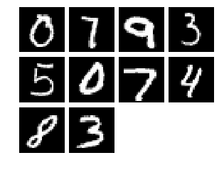
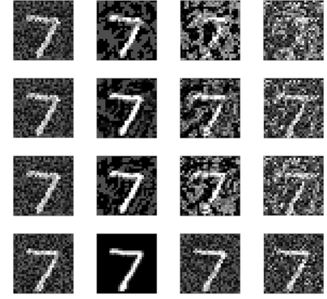

A Comprehensive Testing Framework for AI Systems
A conceptual framework that includes:
An end-to-end pipeline
An error summarization approach for model refinement
Local and global correctness
Specifications
Sampling
Testcase Generation
Testing
Error Summarization
clearly define all necessary properties of the system
gather all relevant samples necessary for thorough model testing
generate different testcases according to the specified properties
assessing local and global correctness
graphical error reports and recommendations for model refinement.
Rotation
Noise
….
Brightness
5
Notes:
We’ve created a complete testing system for AI models. This system helps find and fix weaknesses in AI models before they are used in real life.
Example: Imagine you are designing an autonomous car.Task: Clearly define all the properties the car needs to handle, such as: rotation, noise, brightness)
Example: For the autonomous car, gather data samples for all the situations the car might encounter.
Example: Create different test scenarios based on the specifications.Scenarios: Generate test cases where the stop sign is partially covered by a bird, at night, in heavy rain, or with glare from the sun.
Goal: Ensure the car’s AI can correctly identify and respond to stop signs under all these conditions.
Example: Run the autonomous car through all the test scenarios.Process: Test the car’s AI to see if it stops correctly at each type of stop sign encountered.
Evaluation: Assess how well the car performs in each situation to ensure it makes the right decisions.
Example: Analyze the test results to find where the car’s AI made mistakes.Reporting: Generate reports showing errors, such as failing to stop at a stop sign partially covered by a tree branch.

Slide 6




AI System: The Sum of two Digits using an MNIST Classifier
Maximum probability of correct answer for this pair
MAX(GL_{n}, GL_{r}) = 0.43
+
= 12
Minimum probability
MIN(GL_{n}, GL_{r}) = 0.23
Optimistic view
Pessimistic view
+
=12
+
=12
GL_{n} = LO_{n}(9) * Lo_{n}(3) = 0.43
GL_{r} = LO_{r}(9) * Lo_{r}(3) = 0.23
Global Correctness
9 |
3 |
9 |
3 |
…
…
…
…
LO_{n}(9) = 0.66
LO_{n}(3) = 0.65
LO_{r}(9) = 0.46
LO_{r}(3) = 0.50
Local Correctness
…
…
…
…
Noise property
Rotation property

Slide 7
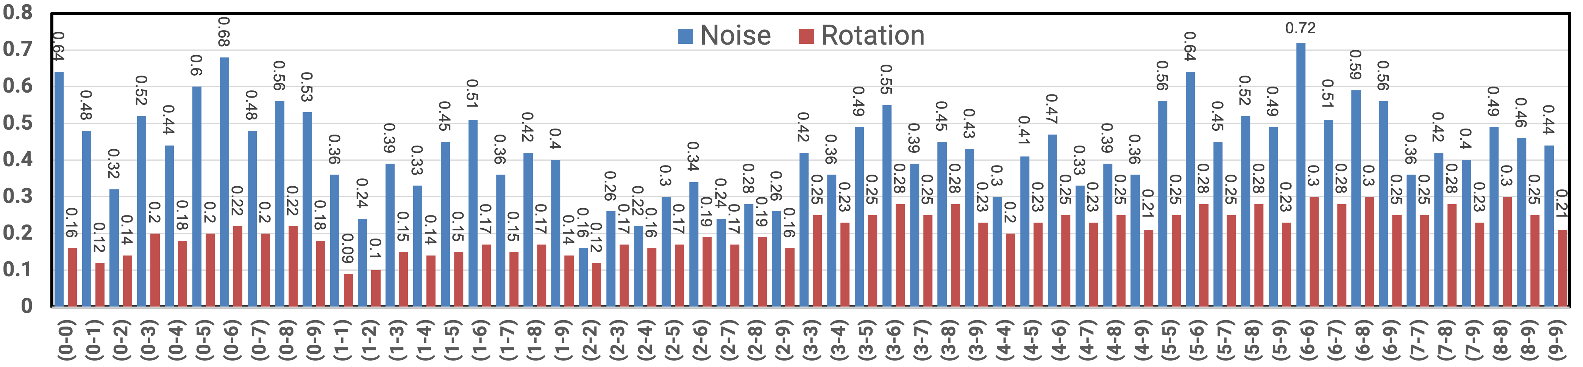
Evaluation for the Sum of two Digits on 1000 samples
We tested 55 unique pairs {d₁, d₂} for 0 ≤ d₁, d₂ ≤ 9
For each pair {d₁, d₂}, the digits were sampled randomly from the corresponding class
We computed the minimum probabilities for each pair (L₁, U₁), …, (L₅₅, U₅₅)
The global pessimistic correctness is 9%
The global optimistic correctness is 72%
7
Notes:
Experimental Setup
Model Architecture
CNN, ResNet architecture
Dataset
MNIST Dataset
Sampling
Random Sampling
100 samples from each class (0-9)
7

